Slide 1
Database control
Introduction

Slide 2
Introduction
The Database control is a tool that used by the database administrator to control the database.
To enter to Database control (start menu-all programs-oracle home-database control). Or enter the following url in your web browser (http://host:service-number/em)
  Where host is (local host or computer name or the IP address for your PC
  Service number is 5500 or 5501. It may take other values.
If you can not enter to the database control you must follow the following steps

Slide 3
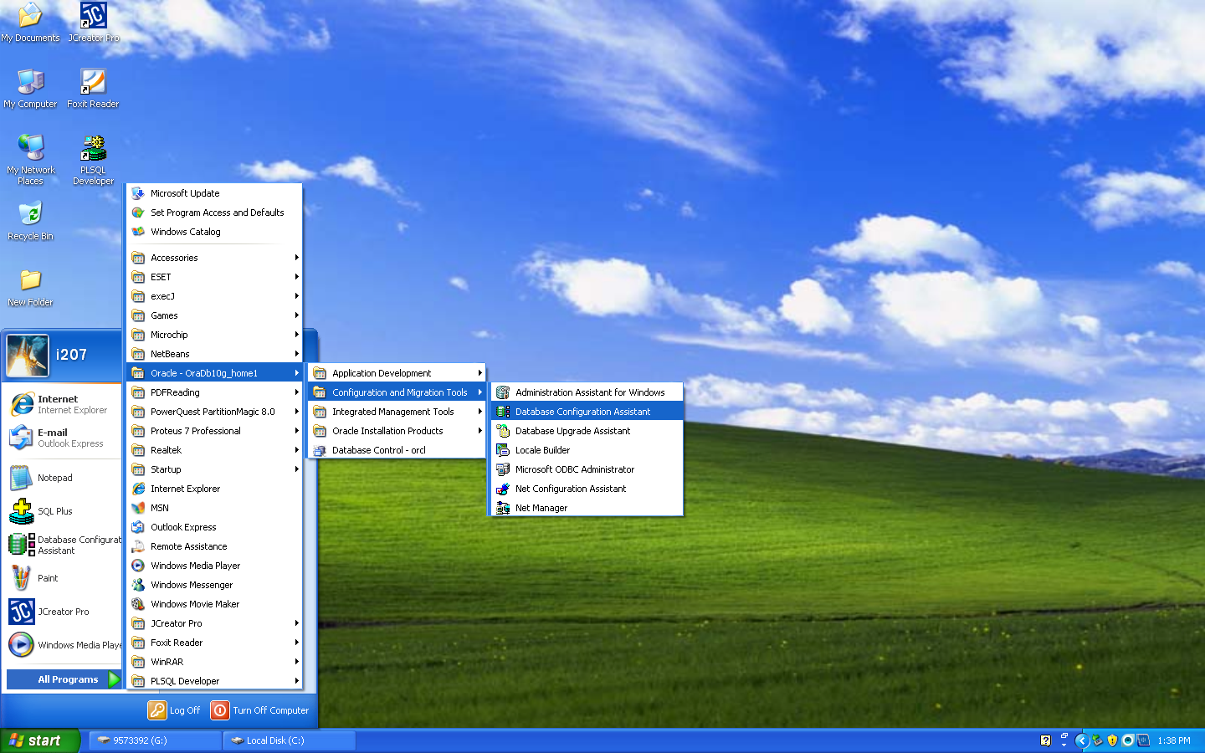
Step 1
Click this item

Slide 4
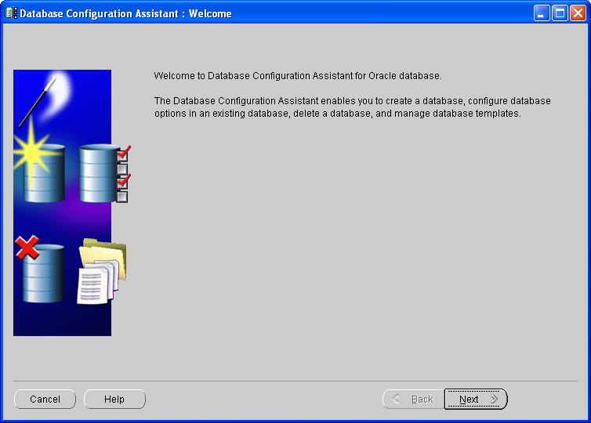
Step 2

Slide 5
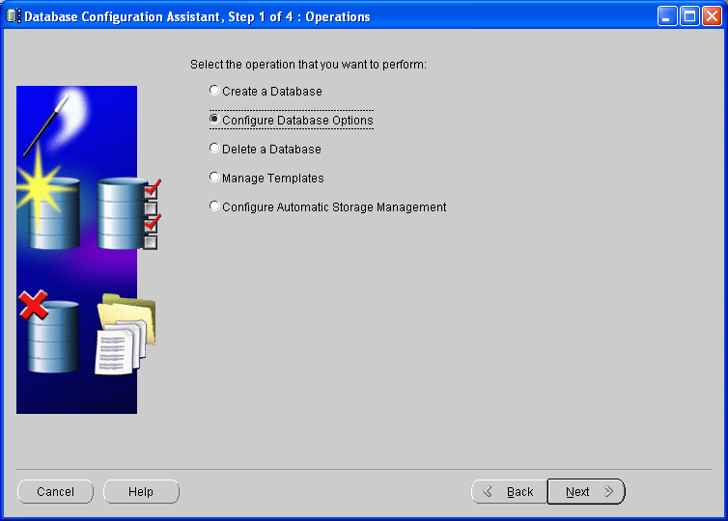
Step 3
Choose this option

Slide 6
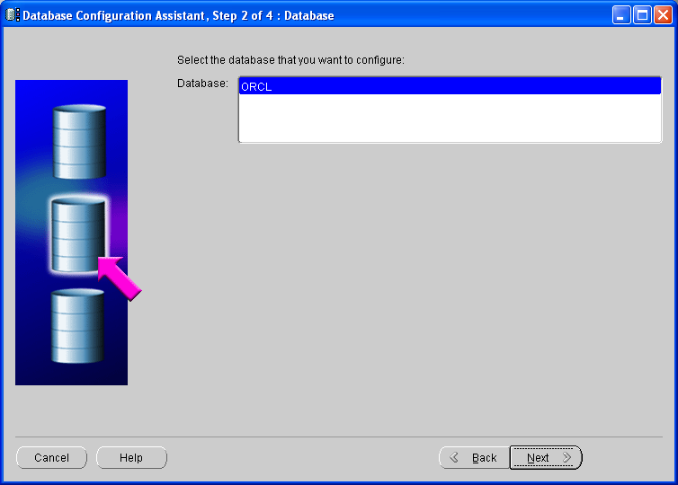
Step 4
Choose database to configure

Slide 7
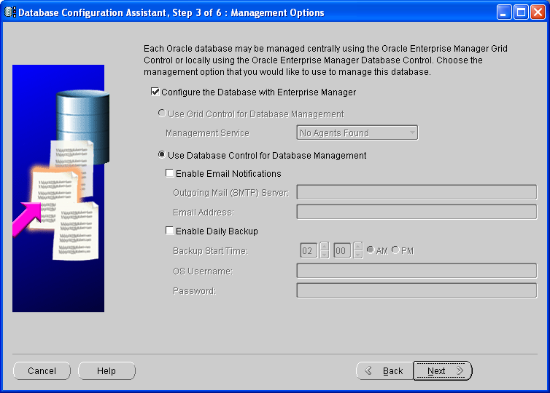
Step 5

Slide 8
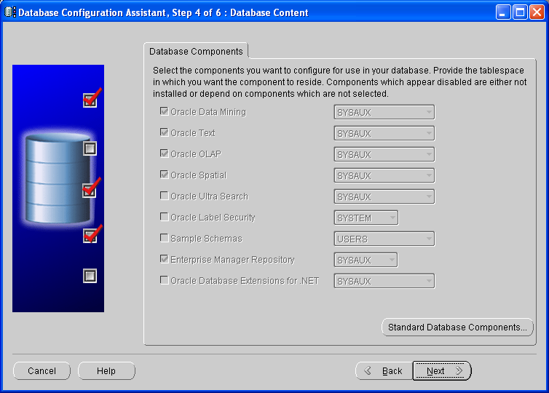
Step 6

Slide 9
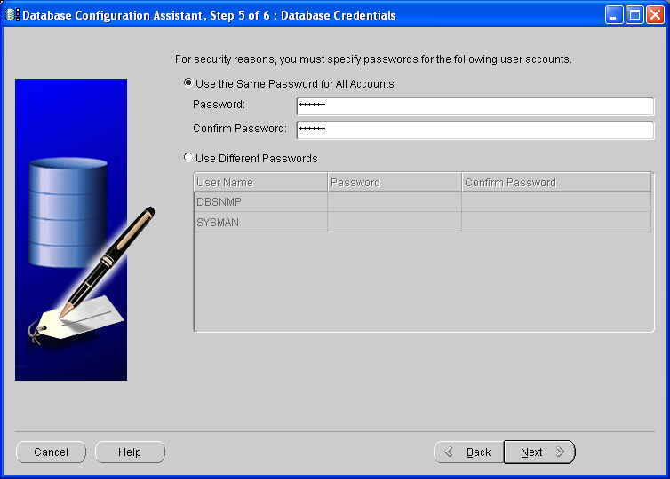
Step 7
Passwords for DBSNMB and SYSMAN our default password is userdb

Slide 10
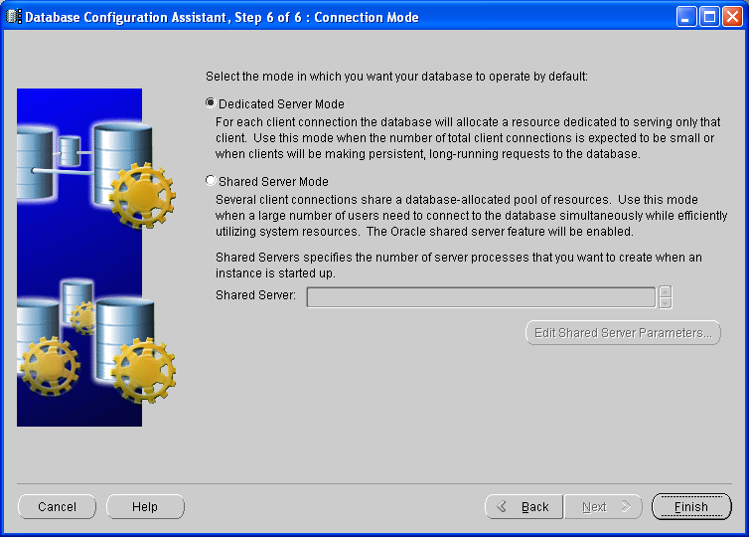
Step 8

Slide 11
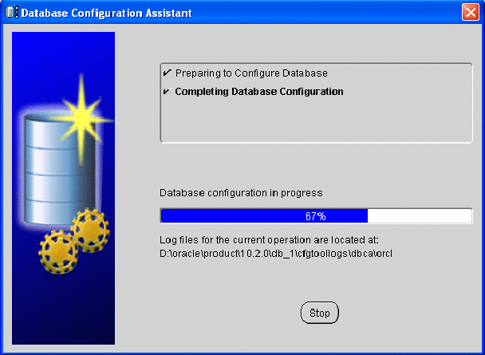
Step 9
This console may be followed by an error console. If this happens you will return to the previous step click finish again

Slide 12
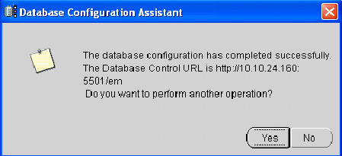
Step 10
This is the url you will enter in the web browser

Slide 13



SQL and iSQL*Plus Interaction
SQL statements
Internet
browser
Oracle
server
iSQL*Plus
commands
Query results
Formatted report
Client
Notes:
SQL and iSQL*Plus
SQL is a command language for communication with the Oracle server from any tool or application. Oracle SQL contains many extensions.
iSQL*Plus is an Oracle tool that recognizes and submits SQL statements to the Oracle server for execution and contains its own command language.
Features of SQL
Can be used by a range of users, including those with little or no programming experience
Is a nonprocedural language
Is an English-like language
Features of iSQL*Plus
Is accessed from a browser
Accepts SQL statements
Provides online editing for modifying SQL statements
Controls environmental settings
Formats query results into a basic report
Accesses local and remote databases

Slide 14
SQL Statements Versus
iSQL*Plus Commands
SQL
  A language
  ANSI standard
  Keyword cannot be abbreviated.
  Statements manipulate data and table definitions in the database.
iSQL*Plus
  An environment
  Oracle-proprietary
  Keywords can be abbreviated.
  Commands do not allow manipulation of values in the database.
  Runs on a browser
  Centrally loaded; does not have to be implemented on each machine
SQL
statements
iSQL*Plus
commands
Notes:
SQL and iSQL*Plus (continued)
The following table compares SQL and iSQL*Plus:

Slide 15
Column Heading Defaults
  iSQL*Plus:
    Default heading alignment: Center
    Default heading display: Uppercase
  SQL*Plus:
    Character and Date column headings are left- aligned
    Number column headings are right-aligned
    Default heading display: Uppercase
Notes:
Column Heading Defaults
In iSQL*Plus, column headings are displayed in uppercase and centered.
SELECT last_name, hire_date, salary
FROM employees;
You can override the column heading display with an alias. Column aliases are covered later in this lesson.
…

Slide 16
Overview of iSQL*Plus
After you log in to iSQL*Plus, you can:
  Describe table structures
  Enter, execute, and edit SQL statements
  Save or append SQL statements to files
  Execute or edit statements that are stored in saved script files
Notes:
iSQL*Plus
iSQL*Plus is an environment in which you can do the following:
Execute SQL statements to retrieve, modify, add, and remove data from the database
Format, perform calculations on, store, and print query results in the form of reports
Create script files to store SQL statements for repeated use in the future
iSQL*Plus commands can be divided into the following main categories:

Slide 17
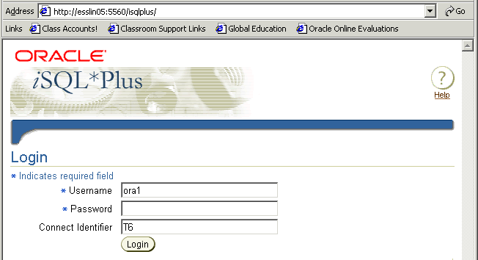
Logging In to iSQL*Plus
  From your browser environment:
Notes:
Logging In to iSQL*Plus
To log in from a browser environment:
1. Start the browser.
2. Enter the URL address of the iSQL*Plus environment.
3. On the Login page, enter appropriate values in the Username, Password, and Connect Identifier fields.

Slide 18
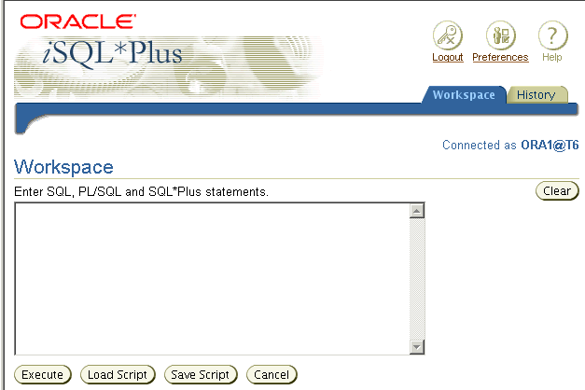
iSQL*Plus Environment
8
9
7
1
6
2
3
4
5
Notes:
iSQL*Plus Environment
In the browser, the iSQL*Plus Workspace page has several key areas:
1. Text box: Area where you type the SQL statements and iSQL*Plus commands
2. Execute button: Click to execute the statements and commands in the text box
3. Load Script button: Brings up a form where you can identify a path and file name or a URL that contains SQL, PL/SQL, or SQL*Plus commands and load them into the text box
4. Save Script button: Saves the contents of the text box to a file
5. Cancel button: Stops the execution of the command in the text box
6. Clear Screen button: Click to clear text from the text box
7. Logout icon: Click to end the iSQL*Plus session and return to the iSQL*Plus Login page
8. Preferences icon: Click to change your interface configuration, system configuration, or password
9. Help icon: Provides access to iSQL*Plus help documentation

Slide 19
Displaying Table Structure
Use the iSQL*Plus DESCRIBE command to display the structure of a table:
DESC[RIBE] tablename
Notes:
Displaying the Table Structure
In iSQL*Plus, you can display the structure of a table by using the DESCRIBE command. The command displays the column names and data types, and it shows you whether a column must contain data (that is, whether the column has a NOT NULL constraint).
In the syntax, tablename is the name of any existing table, view, or synonym that is accessible to the user.

Slide 20

Displaying Table Structure
DESCRIBE employees
Notes:
Displaying the Table Structure (continued)
The example in the slide displays the information about the structure of the DEPARTMENTS table.
In the resulting display, Null? indicates that the values for this column may be unknown. NOT NULL indicates that a column must contain data. Type displays the data type for a column.
The data types are described in the following table:

Slide 21
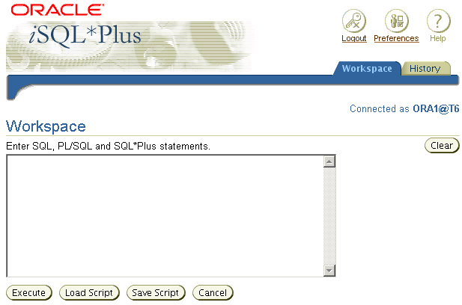
Interacting with Script Files
SELECT last_name, hire_date, salary
FROM employees;
1
2
Notes:
Interacting with Script Files
Placing Statements and Commands into a Text Script File
You can save commands and statements from the text box in iSQL*Plus to a text script file as follows:
1. Type the SQL statements in the text box in iSQL*Plus.
2. Click the Save Script button. This opens the Windows File Save dialog box. Identify the name of the file. The extension defaults to .uix. You can change the file type to a text file or save it as a .sql file.

Slide 22
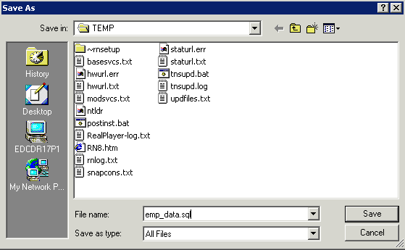
Interacting with Script Files
Notes:
Interacting with Script Files (continued)
In the example shown, the SQL SELECT statement typed in the text box is saved to a file named emp_data.sql. You can choose the type of the file, name of the file, and location of where you want to save the script file.

Slide 23
Interacting with Script Files
1
Notes:
Interacting with Script Files (continued)
Using Statements and Commands from a Script File in iSQL*Plus
You can use previously saved commands and statements from a script file in iSQL*Plus as follows:
1. Click the Load Script button. This opens a form where you can type the name of the file or a URL containing the SQL, PL/SQL, or SQL*Plus commands that you want to enter in the text box.

Slide 24
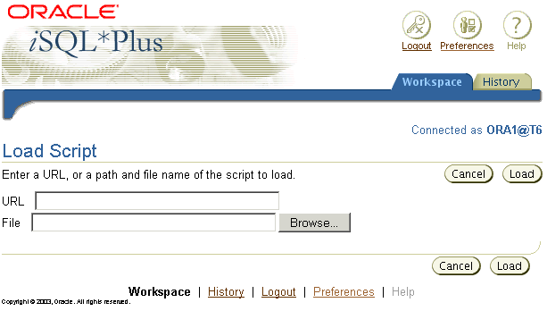
Interacting with Script Files
D:\TEMP\emp_data.sql
2
3
Notes:
Interacting with Script Files (continued)
2. Enter the script name and path, or the URL location. Or you can click the Browse button to find the script name and location.
3. Click the Load button to bring the contents of the file or URL location into the text box.

Slide 25
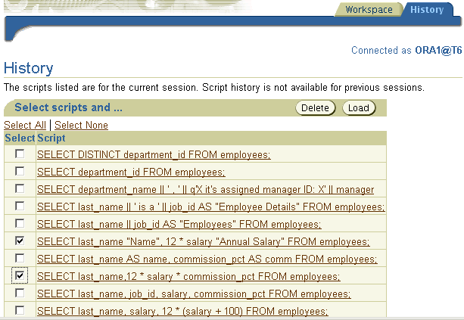
iSQL*Plus History Page
3
2
1
Notes:
Running Previous Statements
The History page in iSQL*Plus lets you execute previously run statements in your session. The History page shows your most recently run SQL statements and iSQL*Plus commands. To rerun the statements:
1. Select the statement that you want to execute.
2. Click the Load button.
Note
You can control the number of statements that are shown on the History page with Preferences settings.
You can choose to delete selected statements by clicking the Delete button.

Slide 26
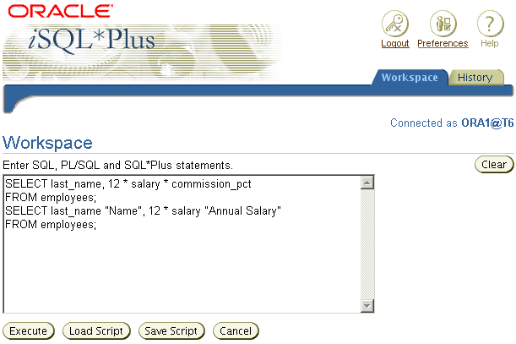
iSQL*Plus History Page
3
4
Notes:
Running Previous Statements (continued)
3. Return to the Workspace page.
4. Click the Execute button to run the commands that have been loaded into the text box.

Slide 27
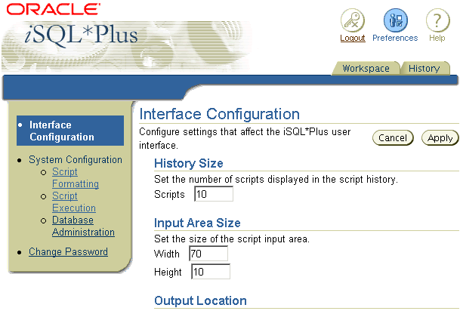
Setting iSQL*Plus Preferences
1
2
3
Notes:
iSQL*Plus Preferences
You can set preferences for your iSQL*Plus session by clicking the Preferences icon.
The preferences are divided into categories. You can set preferences for script formatting, script execution, and database administration, and you can change your password.
When you choose a preference category, a form is displayed that lets you set the preferences for that category.

Slide 28
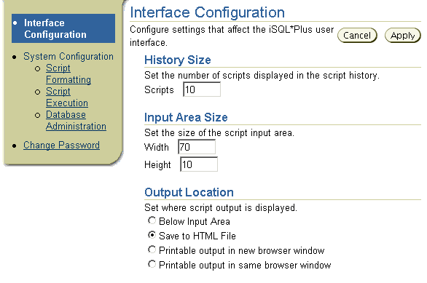
Setting the Output Location Preference
2
1
Notes:
Changing the Output Location
You can send the results that are generated by a SQL statement or iSQL*Plus command to the screen (the default), a file, or another browser window.
On the Preferences page:
1. Select an Output Location option.
2. Click the Apply button.

Slide 29
Summary
In this lesson, you should have learned how to:
  Write a SELECT statement that:
    Returns all rows and columns from a table
    Returns specified columns from a table
    Uses column aliases to display more descriptive column headings
  Use the iSQL*Plus environment to write, save, and execute SQL statements and iSQL*Plus commands
SELECT *|{[DISTINCT] column|expression [alias],...}
FROM table;
Notes:
SELECT Statement
In this lesson, you should have learned how to retrieve data from a database table with the SELECT statement.
SELECT *|{[DISTINCT] column [alias],...}
FROM table;
In the syntax:
SELECT is a list of one or more columns
* selects all columns
DISTINCT suppresses duplicates
column|expression selects the named column or the expression
alias gives selected columns different headings
FROM table specifies the table containing the columns
iSQL*Plus
iSQL*Plus is an execution environment that you can use to send SQL statements to the database server and to edit and save SQL statements. Statements can be executed from the SQL prompt or from a script file.

